Slide 1
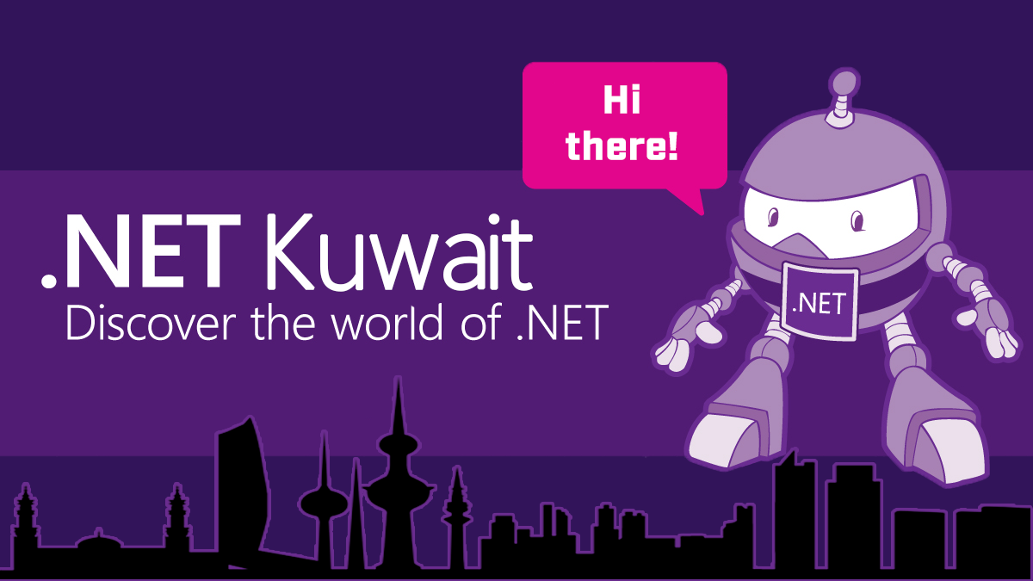
Migrate Web App to Azure
Amir Ismail
Tariq Abubaker

Slide 2
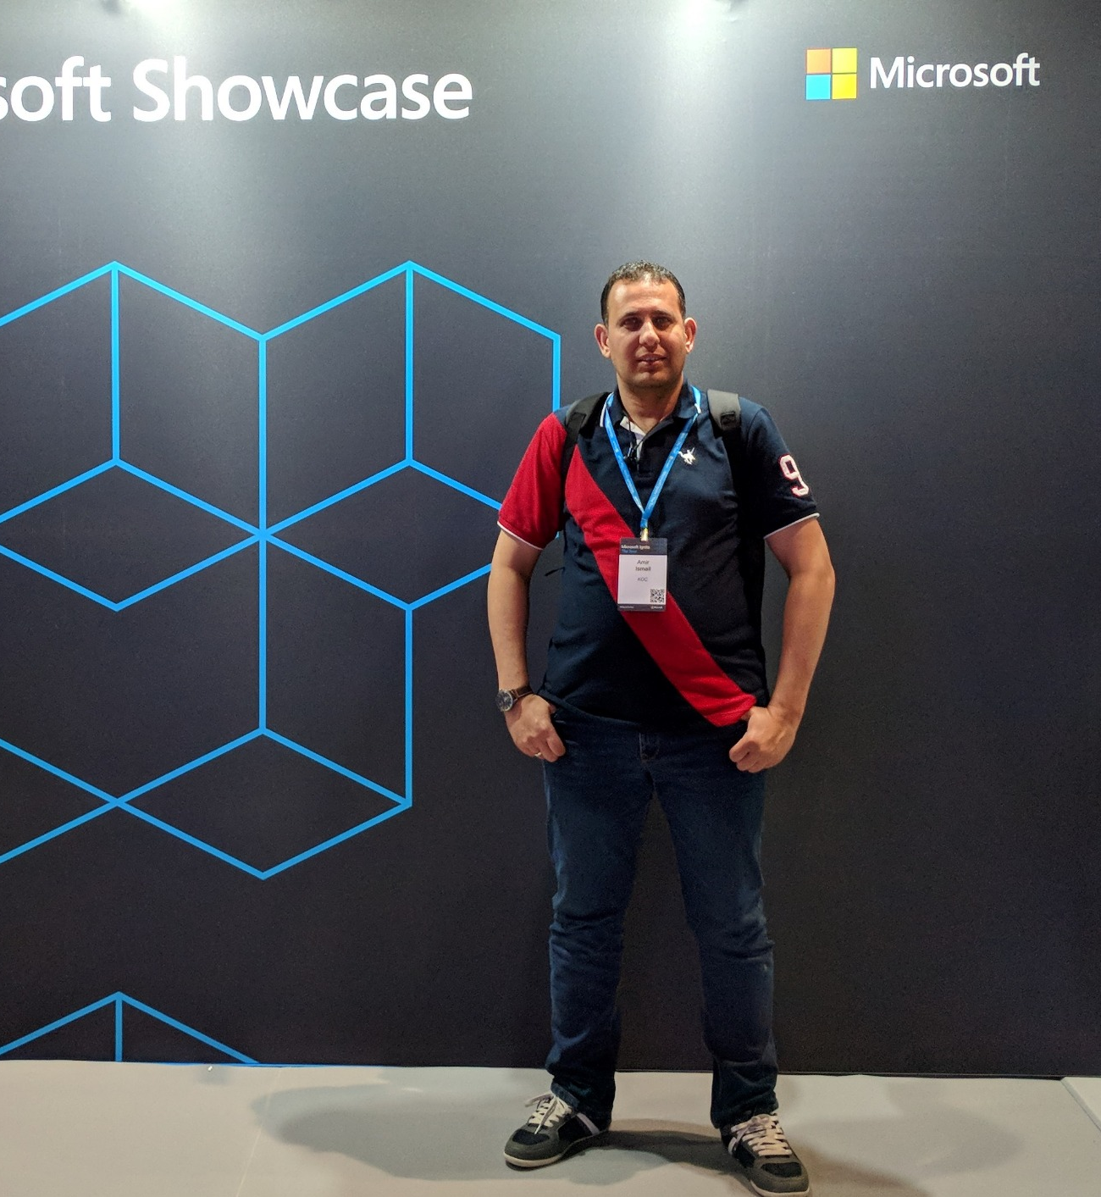


Amir Ismail
Overview
Senior Software Engineer for Kuwait Oil Company.
+15 years of experience in Software Engineering. I participated in multiple projects in different business domains range from E-learning, Banking, Oil, E-booing and Hotels management.
Certifications
PSM I Certified.
ITIL® Certified.
PRINCE2® Certified.
Contact Details
https://www.linkedin.com/in/amirismailyousef/
@miroprocessor

Slide 3
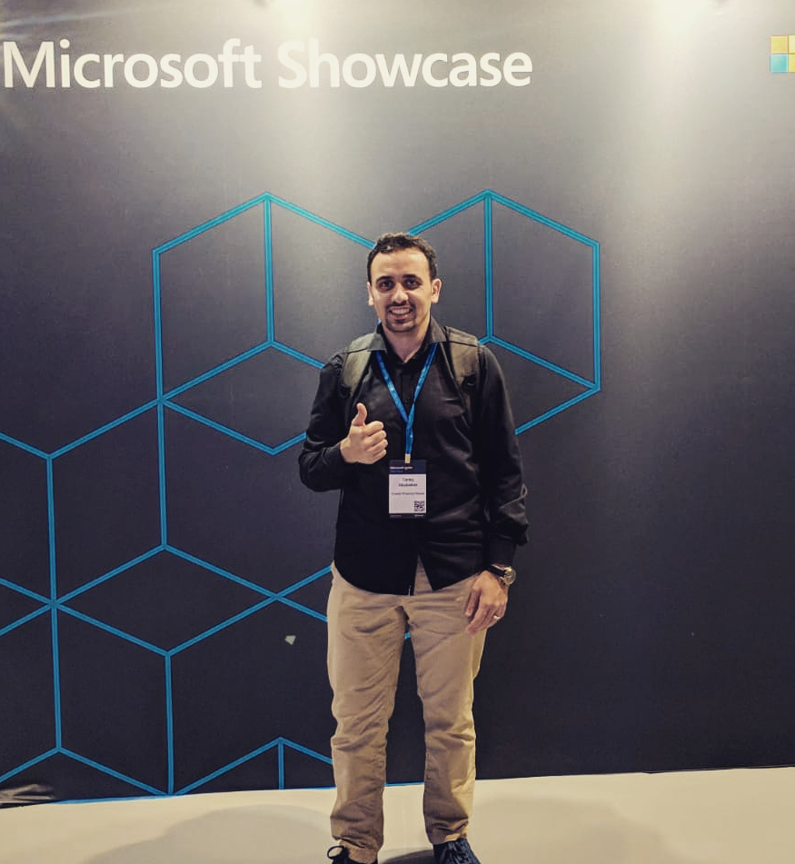
Tariq Abubaker
Overview
IT Enterprise Architect for Kuwait Finance House.
+10 years of experience in the IT and banking industry. I participated multiple projects range from SOA, EA, Core banking, Payment Solutions, Credit Cards, AML and Fraud, CRM, Retail, Finance, and IT service management solutions.
Certifications
TOGAF® 9 Certified.
DevOps Certified.
MCTS: .NET Framework 4, Web Applications.
MCP
Contact Details
https://www.linkedin.com/in/tariq-abubaker/
@taq_abubaker

Slide 4
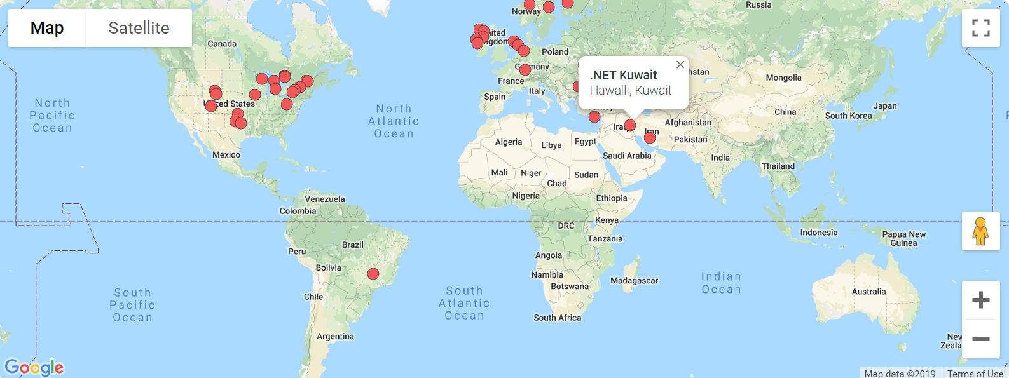
Last Month Update
Become member of Azure Tech Communities

Slide 5
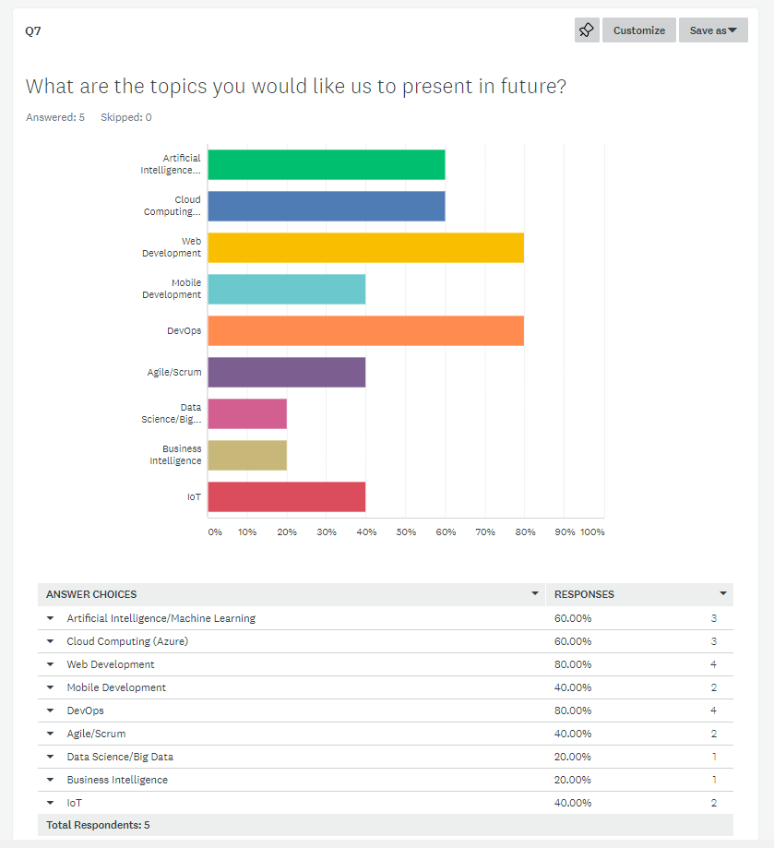
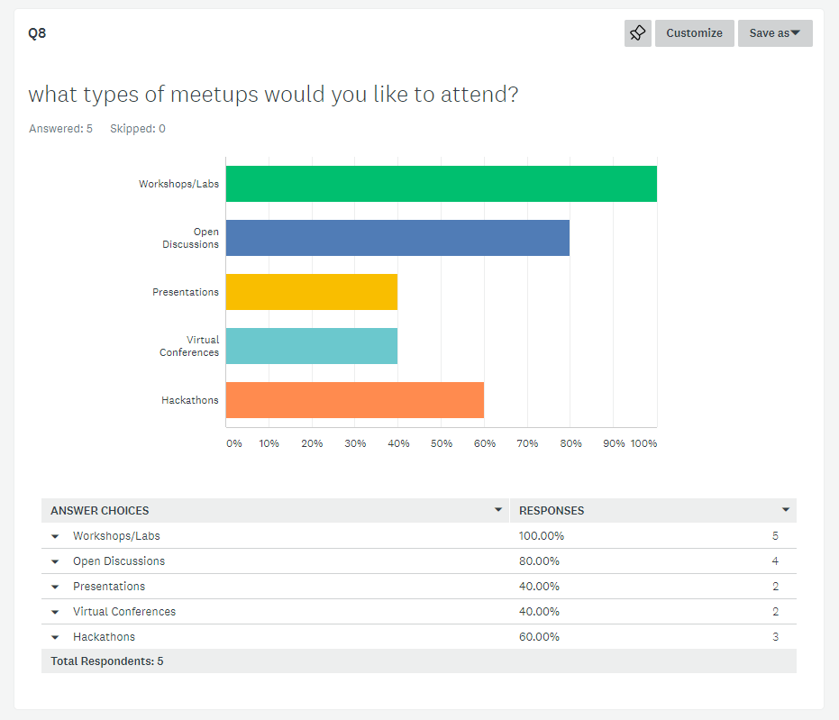
Results from last survey
5 out of the 13 completed the survey which is 38% response rate.

Slide 6

What is cloud computing?
Cloud computing is renting resources.
Cloud provider is responsible for the physical hardware required.
The computing services offered by cloud provider typically include
Compute power - such as Linux servers or web applications
Storage - such as files and databases
Networking - such as secure connections between the cloud provider and your company
Analytics - such as visualizing telemetry and performance data
6

Slide 7
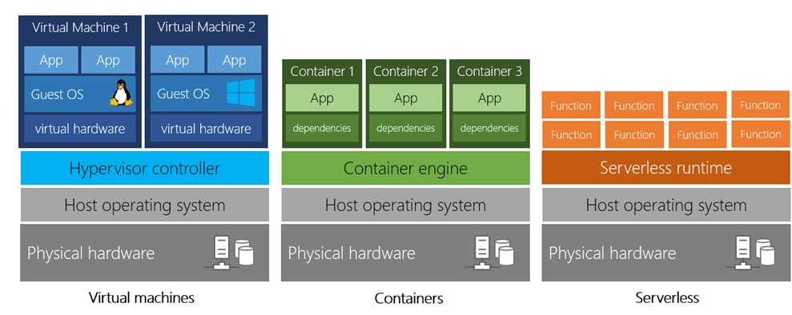
Types of Compute Power
Virtual Machines – VMs
Like a physical computer, includes operating system and hardware.
You can Install whatever software you want.
Gives more control over and responsibilities over maintenance.

Slide 8
Types of Compute Power
Containers (ex: Docker)
Provide a consistent, isolated execution environment for applications.
Similar to VMs except they don't require a guest operating system(no boot time).
The application and all its dependencies is packaged into a "container" and then a standard runtime environment is used to execute the app.

Slide 9
Types of Compute Power
Serverless Computing
Run application code without creating, configuring, or maintaining a server.
You only pay for the processing time used by each function as it executes

Slide 10
Benefits of cloud computing
Cost Effective
No upfront infrastructure costs.
Scalability
As your workload changes due to a spike or drop in demand, a cloud computing system can compensate by automatically adding or removing resources
Current
Focus on building and deploying applications.
Elasticity
No need to purchase infrastructure may not be used.
The ability to pay for additionally resources when they are needed.
The ability to stop paying for resources that are no longer needed.
It can be done manually or automatically based on specific triggers.
Horizontal Scaling(scaling out) adding more servers(VMs) that function together as one unit.
Vertical Scaling(scaling up) adding more resources to the existing server(VM).
Use the latest software and tools.
Maintaining software patches, hardware setup, upgrades automatically done for.
Scale by Edanur Kuntman, Resilience by Attilio Baghino, cloud okay by Weltenraser from the Noun Project

Slide 11
Benefits of cloud computing
Reliable
No upfront infrastructure costs.
Global
Azure is secured with multi-levels of security starting from physical security for accessing data centers building to encrypting your data and files.
Secure
Azure has fully redundant datacenters around the globe in different regions.
No need to purchase infrastructure may not be used.
The ability to pay for additionally resources when they are needed.
The ability to stop paying for resources that are no longer needed.
reliable by Nithinan Tatah, global by wardehpillai from the Noun Project and secure by Vectorstall from the Noun Project

Slide 12
Cloud Deployment Models
Public
Private
Hybrid
Cloud provider is managing and maintaining your resources.
Ex.: Azure, AWS, and Google Cloud.
Your are responsible for managing and maintaining hardware and security.
Allows you run your application in most appropriate location.
You have no local hardware
Your create your own cloud environment in you datacenter.
It combines the public and private clouds.
Each model has its own pros and cons. The selection is based on your business requirement and restrictions.

Slide 13
Types of cloud services
Infrastructure as a Service(IaaS)
It provides the hardware and operating system. It can be used in
Platform as a Service(PaaS)
Its goal is helping you create an application quickly without managing the underlying infrastructure. It is commonly used in following scenarios
Development Framework.
Software as a Service(SaaS)
It is centrally hosted and managed for end user like Dynamics CRM, Skype, and office 365.
Migrating work loads.
Test and development.
Storage, backup, and recovery.
Analytics or business intelligence.
reliable by Nithinan Tatah, global by wardehpillai from the Noun Project and secure by Vectorstall from the Noun Project

Slide 14
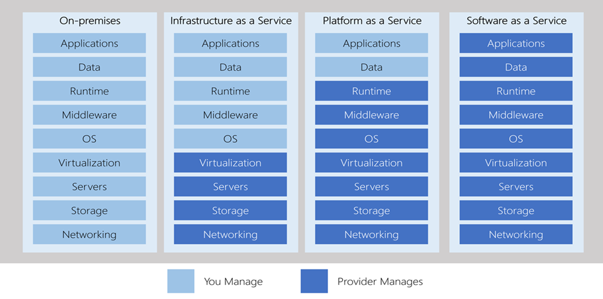
Types of cloud services – Management Responsibilities

Slide 15
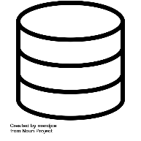

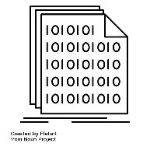
Types of Azure Data Storage
Structured Data
(relational data)
Adheres to a schema, so all of the data has the same fields or properties.
Semi-Structured data
(non-relational or NoSQL)
Uses tags or Keys instead of tables, rows and columns .
Unstructured Data
Has no designated structure.
Can be stored in a database table with row and columns.
Easy to enter, query, and analyze.
All data follows the same format.
Tags or keys are organized in a hierarchy (Documents).
No restrictions on the kind of data it can hold.
Becoming more prominent as business try to tap to a new data source.
Ex: PDFs, media files, JSON files.
database by mardjoe, Unstructured Data by Juicy Fish, binary file by Flatart from the Noun Project

Slide 16
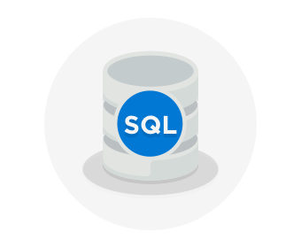
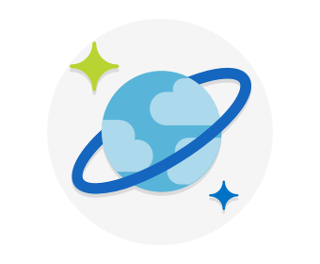

Azure Data Storage Options
Azure SQL Database
Relational database as a service (DaaS).
Latest stable version of MS SQL Server.
Migrate existing DBs to Azure SQL using Azure database Migration Service.
Microsoft Data Migration Assistant generate recommendation report.
Just change the connection string in your Application.
Azure CosmosDB
Distributed database service.
Supports schema-less (NoSQL) data.
Azure Blob Storage
Unstructured which means no restriction on the kind of data.
Highly scalable.
Reached from anywhere.
Ability to store up to 8 TB of data for virtual machines.

Slide 17
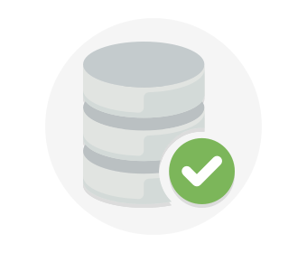
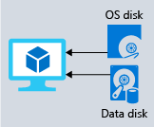
Azure Data Storage Options
Disk Storage
Provides disks for virtual machines and applications to access and use as they need.
Allows data to be stored and accessed from the attached virtual hard disk.
Disks can be managed by azure and managed and configured by user.
Used in lift and shift scenarios or for storing data that is not accessed from outside
the virtual machine.
Different sizes and type (SSD & HDD)

Slide 18
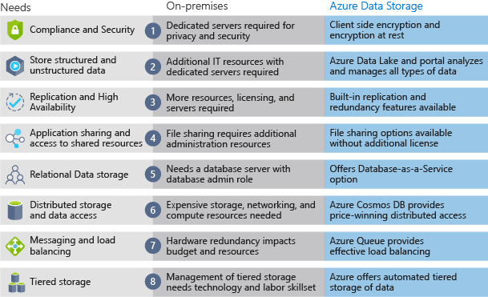
On-Premises vs Azure Storage
Cost Effectiveness
Reliability
Storage Types
Agility
18

Slide 19
Migrating Web App to Azure.
Create an account on Azure(SKIP)
Create a subscription(SKIP)
Create a resource group
Managed by Azure Resource Manager (ARM)
Create a VM.
Create an App Service.
Create a website hosted in Azure
Storage

Slide 20
Demo

Slide 21
Resources
https://docs.microsoft.com/en-us/learn/paths/azure-fundamentals/
https://docs.microsoft.com/en-us/learn/modules/provision-azure-sql-db
https://docs.microsoft.com/en-us/learn/modules/develop-app-that-queries-azure-sql/
https://docs.microsoft.com/en-us/learn/modules/prepare-your-dev-environment-for-azure-development
https://docs.microsoft.com/en-us/learn/modules/host-a-web-app-with-azure-app-service
https://docs.microsoft.com/en-us/learn/modules/publish-azure-web-app-with-visual-studio

Slide 22



Contact Us
@dotnetkw
@dotnetkw
.Net Kuwait

Slide 23
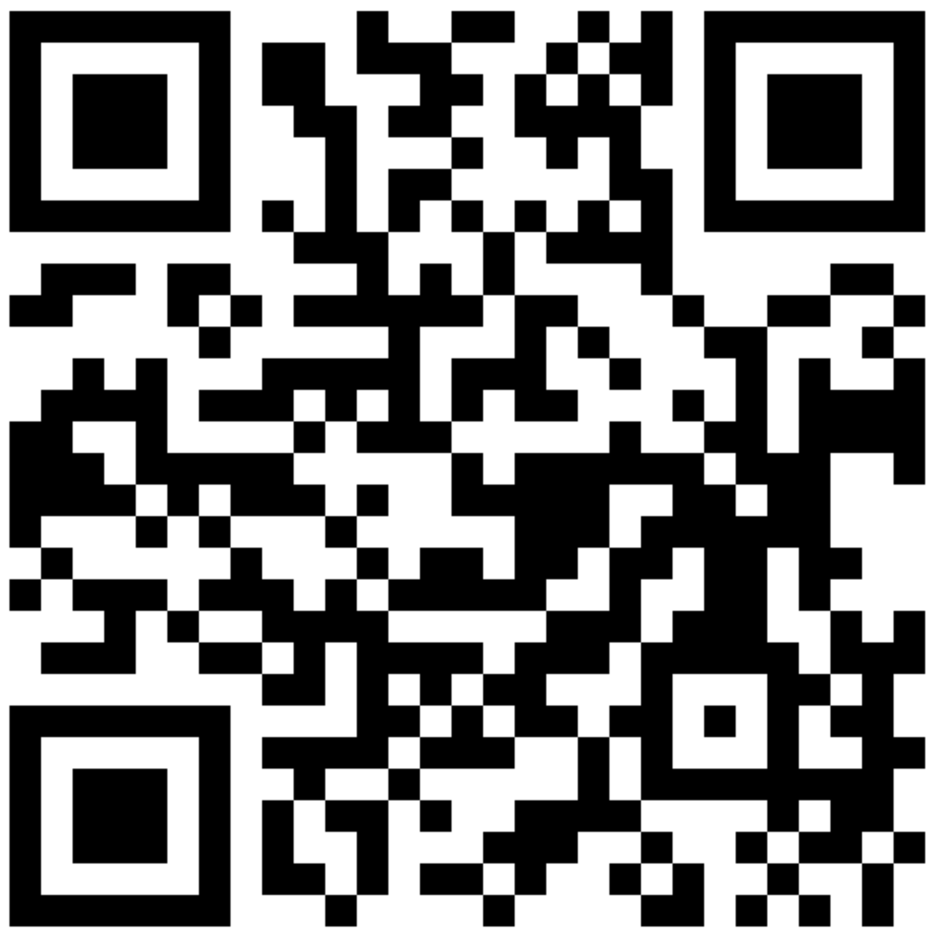
SCAN THE CODE & START YOUR Migration today
https://aka.ms/AA6923d
23

Slide 24

SCAN THE CODE & SEND US YOUR FEEDBACK!
http://bit.ly/2pDgRit
24

Slide 25

Thank You

